Slide 1
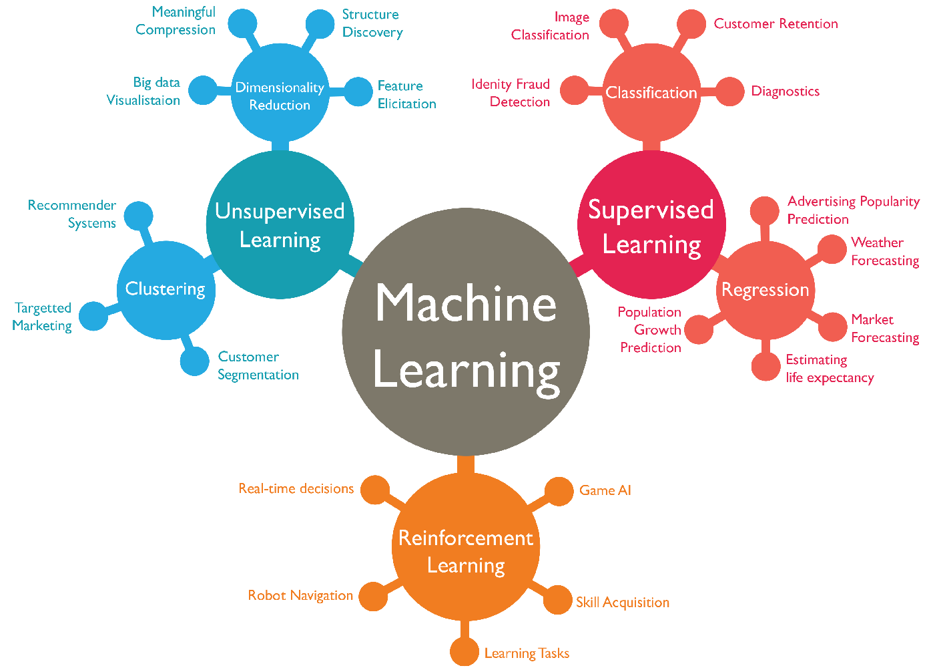

Machine Learning
Course Code: CSDLO6021
Credits: 4
IA: 20 Marks
ESE: 80 Marks

Slide 2
Objectives
To introduce the basic concepts and techniques of Machine Learning.
To become familiar with regression methods, classification methods and clustering methods.
To become familiar with Dimensionality Reduction Techniques.

Slide 3
Outcomes
Gain knowledge about basic concepts of Machine Learning.
Identify machine learning techniques suitable for a given problem.
Solve the problems using various machine learning techniques.
Apply dimensionality reduction techniques.
Design applications using machine learning techniques.

Slide 4
Syllabus
Module 1: Introduction to Machine Learning
Machine Learning
Types of Machine Learning
Issues in Machine Learning
Applications of Machine Learning
Steps in developing a Machine Learning Application
University Question Paper Weightage:
May 2019: 15 Marks
Dec 2019: 5 Marks

Slide 5
Syllabus
Module 2: Introduction to Neural Network
Introduction
Fundamental Concept
Evolution of Neural Networks
Biological Neurons
Artificial Neural Networks
NN Architecture
Activation Functions
McCulloch-Pitts Model
University Question Paper Weightage:
May 2019: 5 Marks
Dec 2019: 15 Marks

Slide 6
Syllabus
Module 3: Introduction to Optimization Techniques
Derivative Based Optimization
Steepest Descent
Newton Method
Derivative Free Optimization
Random Search
Down Hill Simplex
University Question Paper Weightage:
May 2019: 25 Marks
Dec 2019: 10 Marks

Slide 7
Syllabus
Module 4: Learning with Regression and Trees
Learning with Regression
Linear Regression
Logistic Regression
Learning with Trees
Decision Trees
Constructing Decision Trees with Gini Index
Classification and Regression Trees (CART)
University Question Paper Weightage:
May 2019: 10 Marks
Dec 2019: 20 Marks

Slide 8
Syllabus
Module 5: Learning with Classification and Clustering
Classification
Rule based classification
Classification by Bayesian Belief Networks
Hidden Markovian Models
Support Vector Machine
Maximum Margin Linear Separators
Quadratic Programming Solution to find maximum margin separators
Kernels for learning non-linear functions
Clustering
Expectation Maximization Algorithm
Supervised Learning after Clustering
Radial Basis Functions
University Question Paper Weightage:
May 2019: 45 Marks
Dec 2019: 60 Marks

Slide 9
Syllabus
Module 6: Dimensionality Reduction
Dimensionality Reduction Techniques
Principal Component Analysis
Independent Component Analysis
Single Value Decomposition
University Question Paper Weightage:
May 2019: 20 Marks
Dec 2019: 20 Marks

